Slide 1

Map/ Mapping in Contemporary Art
SciArt Unit: Travel/ Travelling

Slide 2
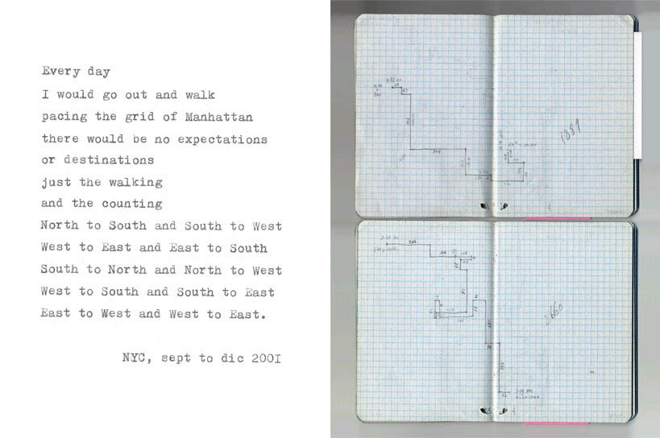
Mapping/ Walking Experience
Artist: Francis Alys

Slide 3
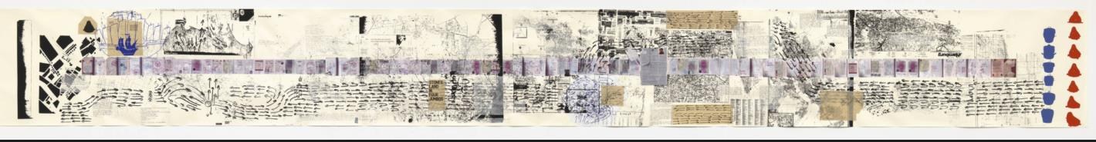
Mapping Feelings
Artist: Rirkrit Tiravanja
Rirkrit Tiravanja, Untitled 2008-2011 (The map of the land of feeling), scroll with digital printing, lithography, chine colle and screenprint
Resource/Link: https://www.moma.org/collection/works/147128?sov_referrer=art_term&art_term_slug=maps-borders-and-networks ).

Slide 4
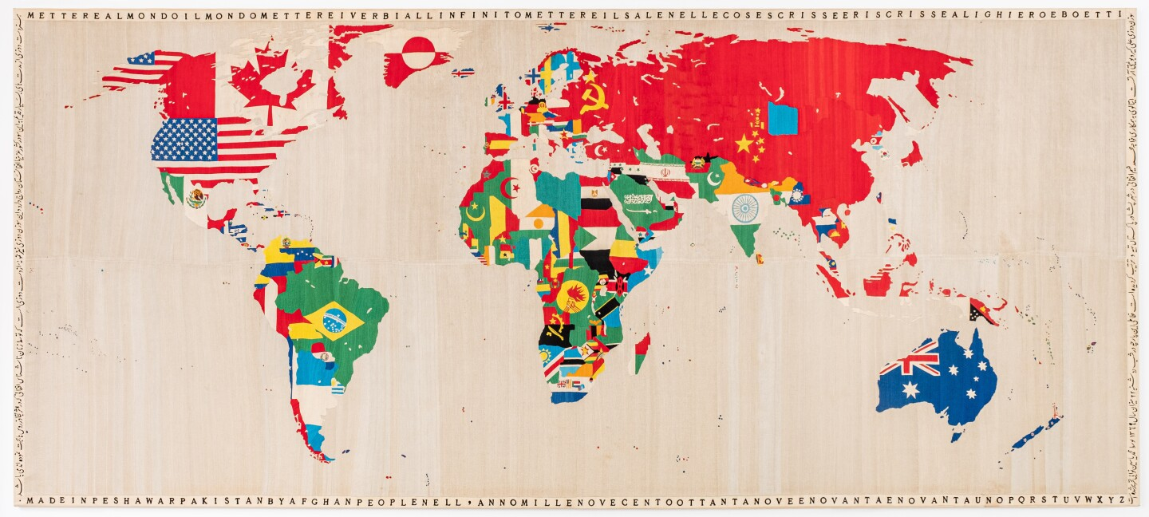
Artist: Alighiero Boetti
ALIGHIERO BOETTI, MAPPA, 1989-1991.
Resource/ Link: https://www.sothebys.com/en/articles/alighiero-boettis-mappa

Slide 5
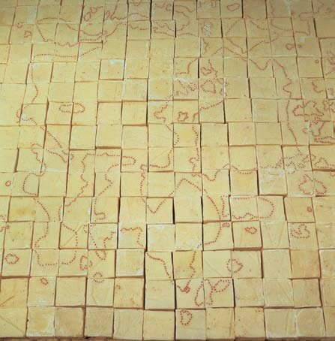
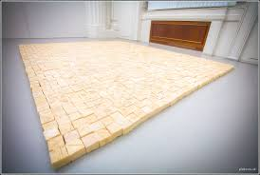
Mapping Memory
Artist: Mona Hatoum
Mona Hatoum, Present Tense, 1996, soap and glass beads, 4.5 × 241 × 299 cm, installation at Anadiel Gallery, Jerusalem. Courtesy White Cube and Anadiel Gallery, Jerusalem.
Resource/Link: https://www.researchgate.net/publication/292499477_Sites_and_senses_mapping_Palestinian_territories_in_Mona_Hatoum%27s_sculpture_present_tense/figures?lo=1

Slide 6
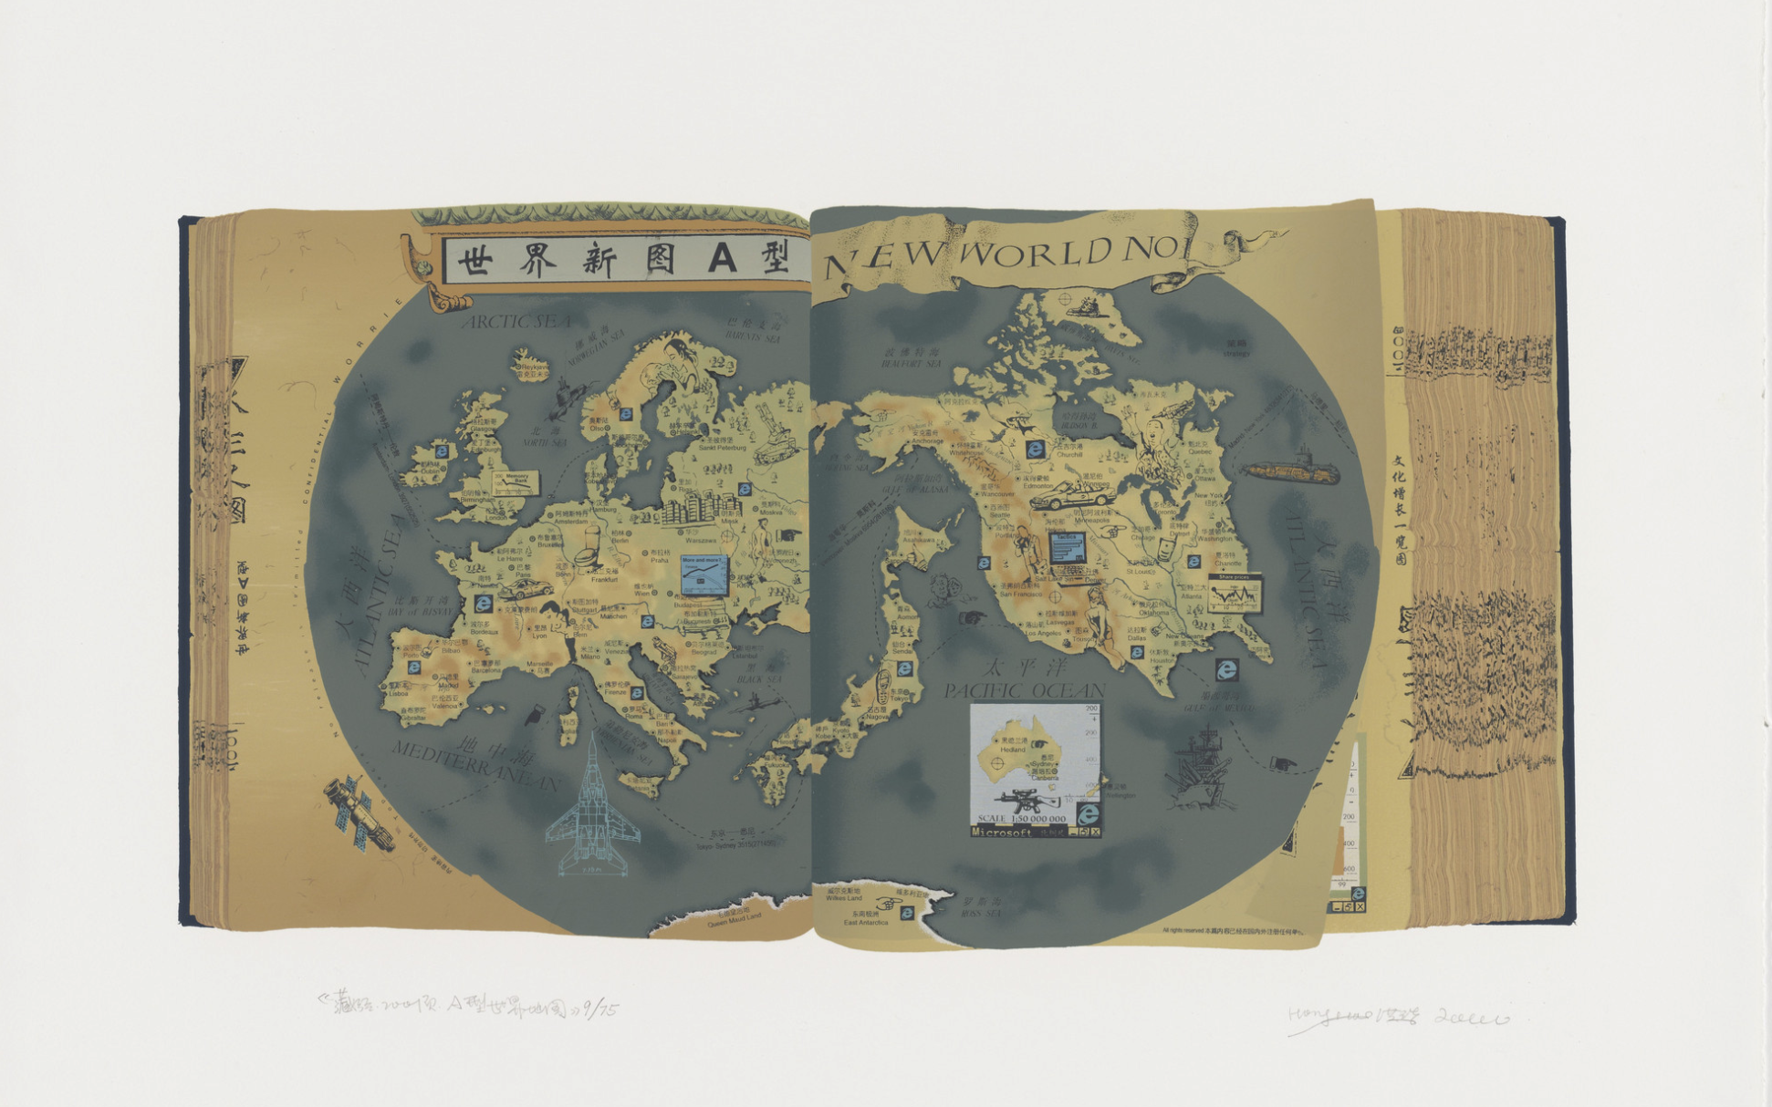
An alternative world map
Artist: Hong Hao
Hong Hao. The World Map A. 2000. Screenprint. composition (irreg.): 12 3/4 x 23 5/8" (32.4 x 60 cm); sheet: 22 7/16 x 30" (57 x 76.2 cm).
Resource/ Link: https://www.moma.org/collection/works/90652

Slide 7
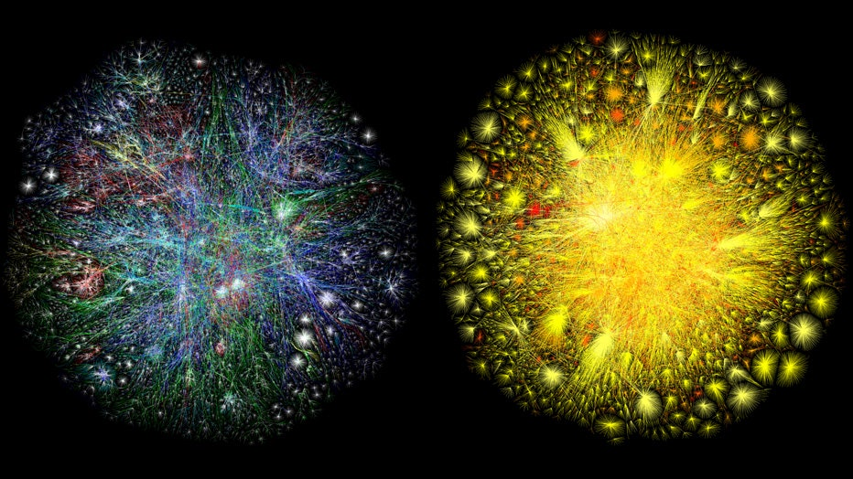
Mapping the Internet
Artist: Barrett Lyon
Barrett Lyon, Map of the Internet, 2003
from The Opte Project
(Resource/ Link: https://www.opte.org/the-internet)

Slide 8
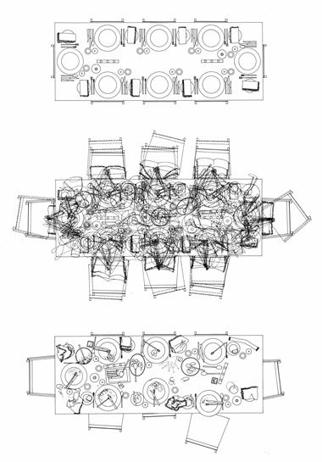
Mapping the everyday
Sarah Wigglesworth
Time/ Layering
Sarah Wigglesworth, The Dining Room Table Drawing 2001
Resource/ Link: https://www.architectural-review.com/essays/folio/folio-sarah-wigglesworths-dining-tables

